Slide 1
Review Vietnamese Quantum Computing Book
27 – 9 – 2020

Slide 2
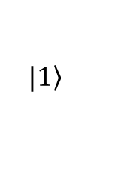

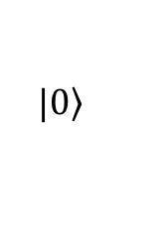




Overview
$$\left.|0\right\rangle$$
$$z$$
$$UV$$
$$V$$
$$y$$
$$x$$
$$\left.|1\right\rangle$$

Slide 3
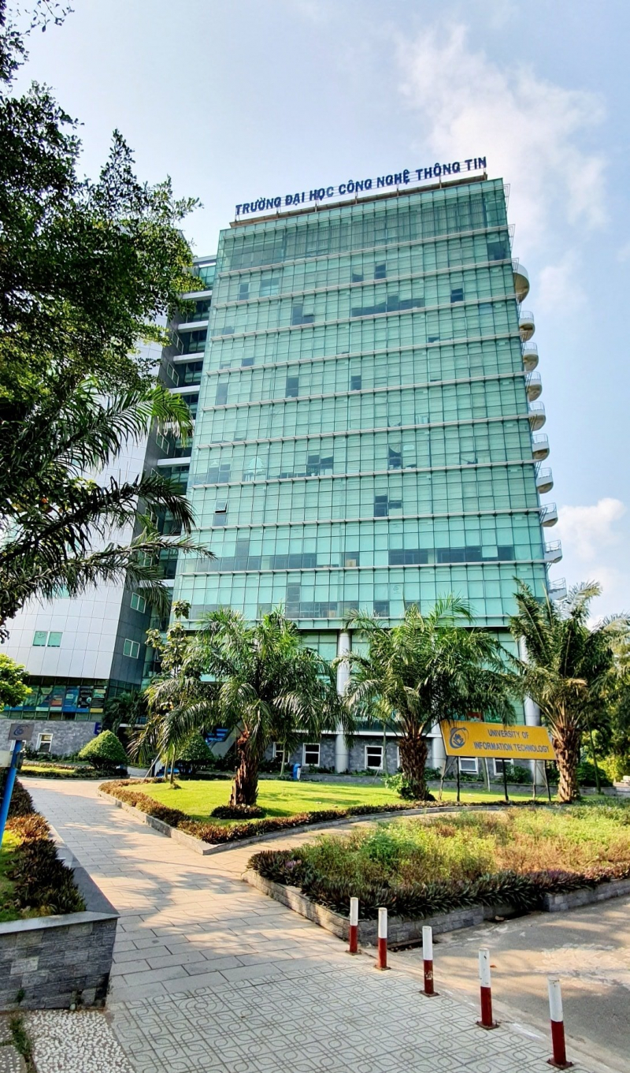
1. About me
Vu Tuan Hai
Faculty of SE, UIT - VNUHCM

Slide 4
2. Overview
Time / Space Complexity
Computer Science
Algorithm
Computer Engineeing
Qubit, Quantum gate
Math,
Quantum theory
Computer Science perspective
Quantum Assembly
Software Engineering
Quantum Programming
Quatum Data compression
Quantum Crytography
Networking
Quantum Teleportation
Error – code correction

Slide 5
Khoa học máy tính
Thuật toán lượng tử [6]
Độ phức tạp [8]
Toán & lý thuyết lượng tử cơ bản
[1, 2, 3, 4]
Kỹ thuật máy tính
Qubit, cổng lượng tử [5]
Phần cứng lượng tử [11]
Công nghệ phần mềm
Lập trình lượng tử [7]
Mạng máy tính & truyền thông
Lý thuyết thông tin [10]
Mật mã lượng tử [9]

Slide 6
3. The book
Number of pages: 183
Reference: Quantum Computing for Computer Scientists (2008)

Slide 7
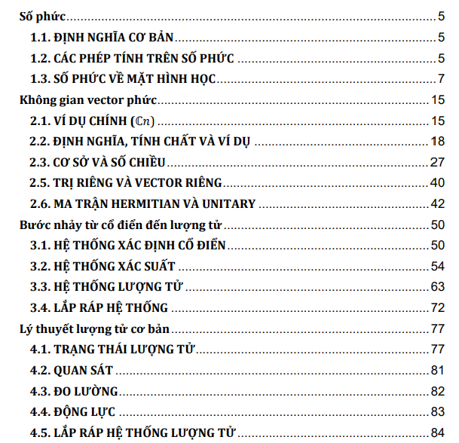
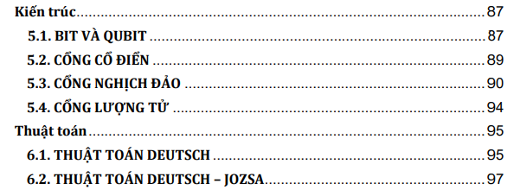
3.1. Menu

Slide 8
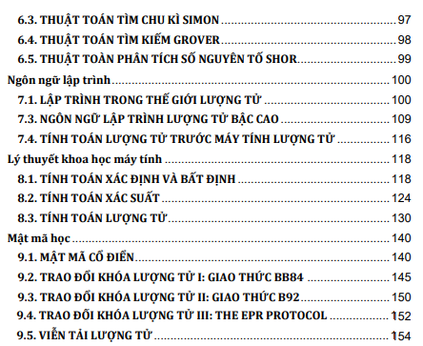
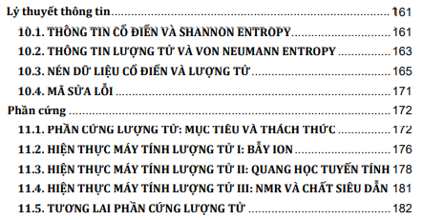
3.2. Menu

Slide 9

Content
Ma trận vuông
Hermitian
$$\begin{matrix}I \\ −I\end{matrix}$$
Unitary
Khả nghịch

Slide 10
1. Basic knowledges

Slide 11










1.1. Chapter 1 & 2: Math
$$rW$$
Complex number
Complex vector space: isometric
Inner product & Hilbert space
Inner product space
Hermitian & Unitary matrix
Tensor product
$$rV$$
$$r(V+W)$$
$$V$$
$$W$$
$$rV$$
$$rW$$
$$V+W$$
$$V$$
$$W$$

Slide 12
1.2. Chapter 3: Modeling QC

Slide 13
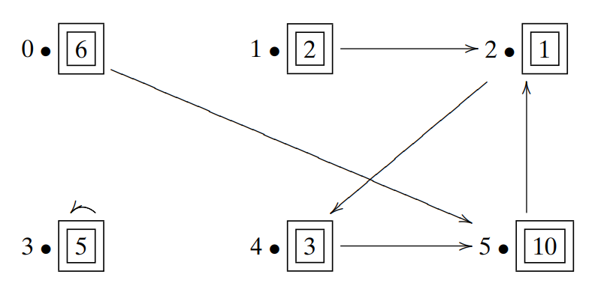


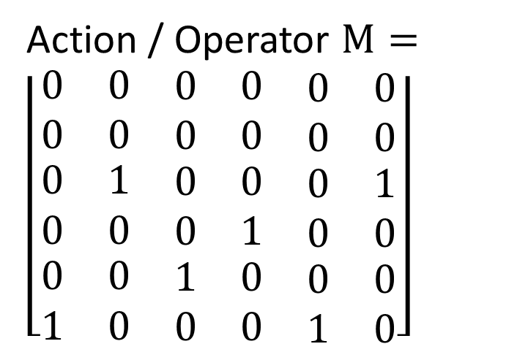
1.2.1. Classical
Action / Operator $M=\left\lfloor \begin{matrix}\begin{matrix}0 & 0 & \begin{matrix}0 & 0 & \begin{matrix}0 & 0\end{matrix}\end{matrix}\end{matrix} \\ \begin{matrix}0 & 0 & \begin{matrix}0 & 0 & \begin{matrix}0 & 0\end{matrix}\end{matrix}\end{matrix} \\ \begin{matrix}\begin{matrix}0 & 1 & \begin{matrix}0 & 0 & \begin{matrix}0 & 1\end{matrix}\end{matrix}\end{matrix} \\ \begin{matrix}0 & 0 & \begin{matrix}0 & 1 & \begin{matrix}0 & 0\end{matrix}\end{matrix}\end{matrix} \\ \begin{matrix}\begin{matrix}0 & 0 & \begin{matrix}1 & 0 & \begin{matrix}0 & 0\end{matrix}\end{matrix}\end{matrix} \\ \begin{matrix}1 & 0 & \begin{matrix}0 & 0 & \begin{matrix}1 & 0\end{matrix}\end{matrix}\end{matrix}\end{matrix}\end{matrix}\end{matrix}\right\rfloor$
State $X_{t}={\text{[}\text{6}\text{, }\text{2}\text{, }\text{1}\text{, }\text{5}\text{, }\text{3}\text{, }\text{10}\text{]}}^{T}$
Classical system
State $X_{t+1}={MX_{t}\text{ = }\text{[}\text{0}\text{, }\text{0}\text{, }\text{12}\text{, }\text{5}\text{, }\text{1}\text{, }\text{9}\text{]}}^{T}$

Slide 14
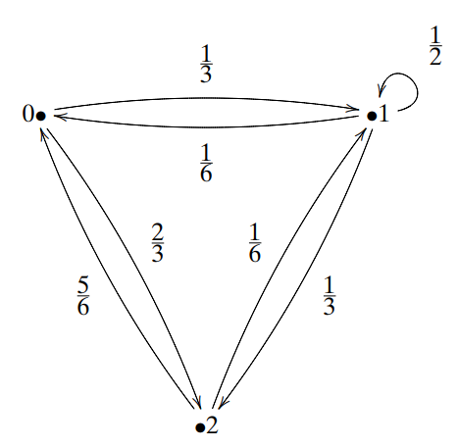

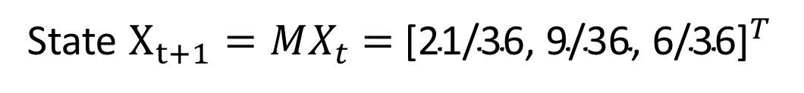
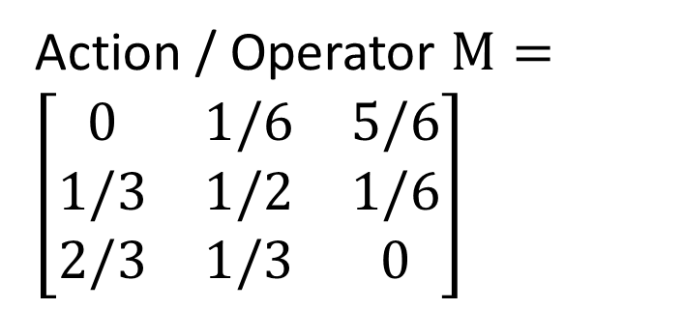
1.2.2. Dynamic
Action / Operator $M=\left[\begin{matrix}0 & 1/6 & 5/6 \\ 1/3 & 1/2 & 1/6 \\ 2/3 & 1/3 & 0\end{matrix}\right]$
State $X_{t}={\text{[}\text{1/6, 1/6, 2/3}\text{]}}^{T}$
State $X_{t+1}={MX_{t}\text{ = }\text{[}\text{21/36}\text{, 9/36, 6/36}\text{]}}^{T}$
Dynamic system

Slide 15
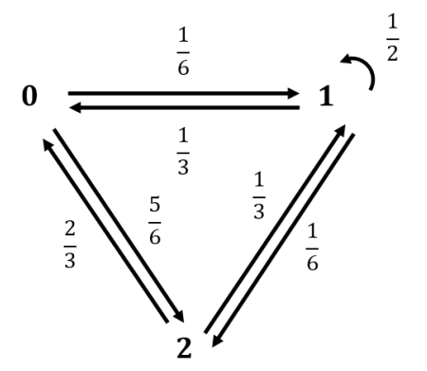




1.2.2. Dynamic
$$M$$
Action / Operator $M=\left[\begin{matrix}0 & 1/6 & 5/6 \\ 1/3 & 1/2 & 1/6 \\ 2/3 & 1/3 & 0\end{matrix}\right]$
$$M^{T}$$
State $W$ $={\text{[}\text{1/3, 0, 2/3}\text{]}}^{T}$
State $WM =Z= {\left[\frac{4}{9},\frac{5}{18},\frac{5}{18}\right]}^{T}$
$$M^{T}W^{T}={\left(WM\right)}^{T}=Z^{T}$$
Dynamic system

Slide 16
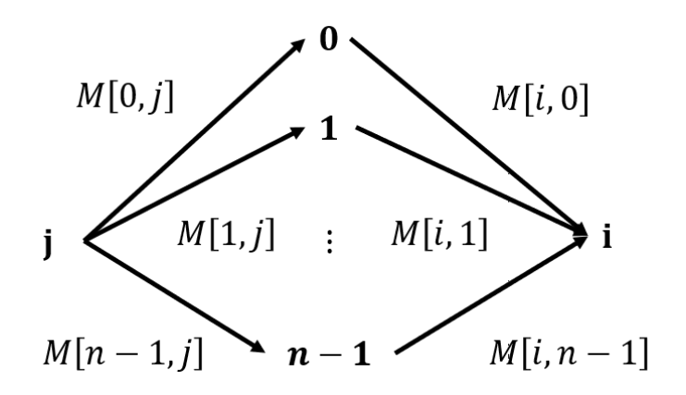
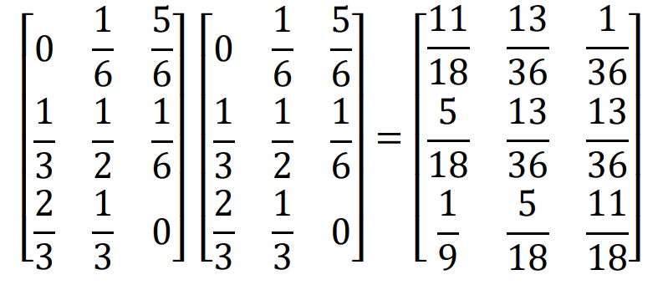
1.2.2. Dynamic
$$M∗M=M^{2}=$$
[0, 0]
[1, 0]
[1, 1]

Slide 17
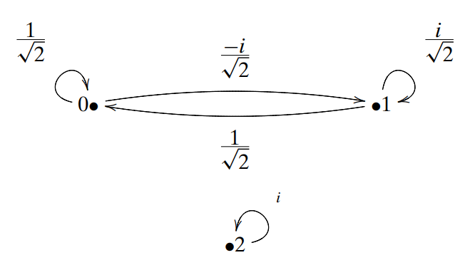
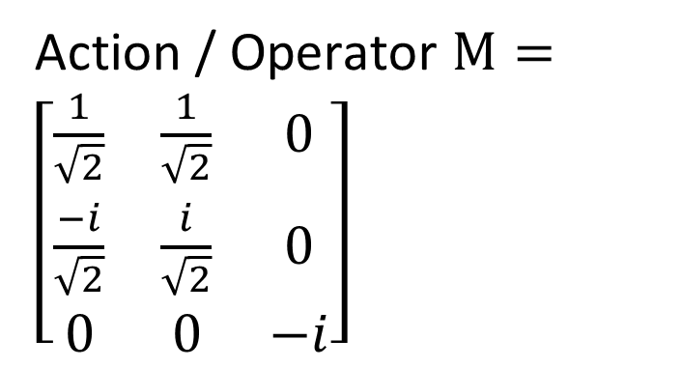



1.2.3. Quantum
Action / Operator $M=\left[\begin{matrix}\frac{1}{\sqrt{2}} & \frac{1}{\sqrt{2}} & 0 \\ \frac{−i}{\sqrt{2}} & \frac{i}{\sqrt{2}} & 0 \\ 0 & 0 & −i\end{matrix}\right]$
$M$is a Unita matrix$. M∗M^{†}=I$
State $X_{t}={\text{[}\frac{1}{\sqrt{3}}\text{, }\frac{2i}{\sqrt{15}}\text{, }\sqrt{\frac{2}{15}}\text{]}\text{]}}^{T}$
State $X_{t+1}={MX_{t}\text{ = }\text{[}\frac{5+2i}{\sqrt{30}},\frac{−2−\sqrt{5}i}{\sqrt{30}}\text{,}\sqrt{\frac{2}{5}}i\text{]}}^{T}$
Quantum system

Slide 18
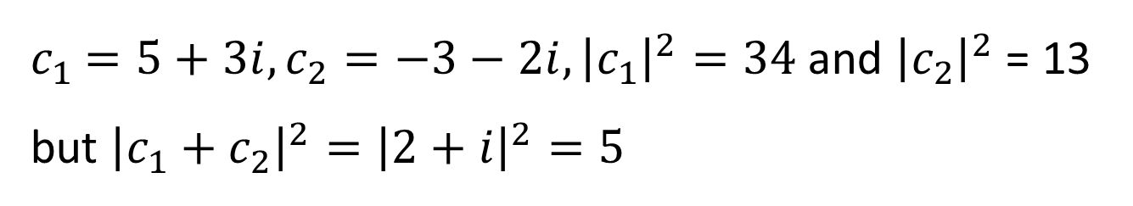
1.2.3. Quantum
Why quantum system must use complex numbers?
If $p_{1},$ $p_{2}$ are real numbers $∈[0,1]$, ($p_{1}$ + $p_{2})$ ≥ $p_{1}$ and ($p_{1}$ + $p_{2}$) ≥ $p_{2}$
$c_{1}$ $=5+3i, c_{2}=−3−2i, {\left|c_{1}\right|}^{2}=34$and ${\left|c_{2}\right|}^{2}$ = 13 but ${\left|c_{1}+c_{2}\right|}^{2}={\left|2+i\right|}^{2}=5$

Slide 19
1.3. Chapter 4: Quantum theory
Superposition
Observe
Measurement
Dynamic
Summary of quantum system

Slide 20
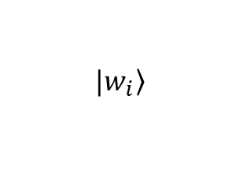
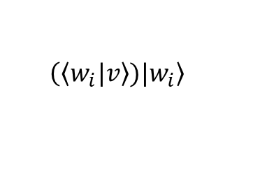
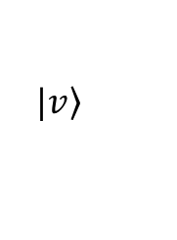
1.3.1. Observe
Observe
$$\left.|v\right\rangle$$
$$\left.|w_{i}\right\rangle$$
$$\left(\left.\left\langle w_{i}|\right.v\right\rangle )\left.|w_{i}\right\rangle \right.$$

Slide 21
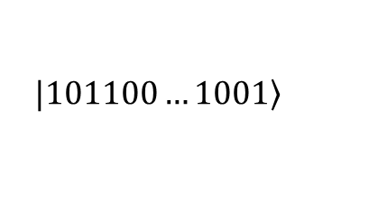
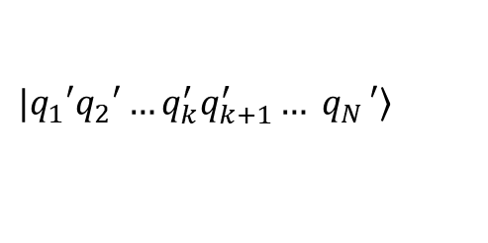
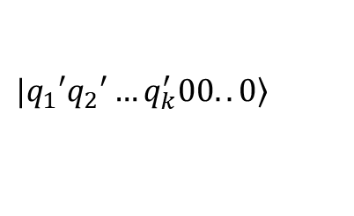
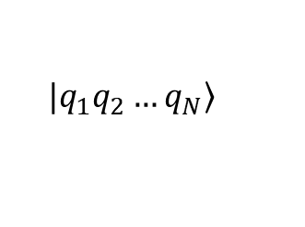
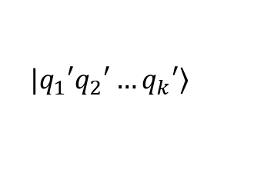

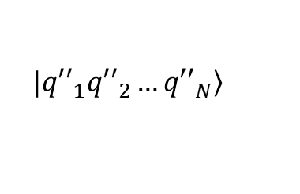
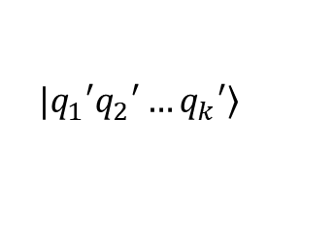

1.3.2. Measurement
$$QC$$
Cắt ngắn
$$\left.|q_{1}q_{2}…q_{N}\right\rangle$$
$$\left.|q_{1}′q_{2}′…q_{k}^{′}q_{k+1}^{′}{… q}_{N}′\right\rangle$$
$$\left.|q_{1}′q_{2}′…q_{k}′\right\rangle$$
Đệm
$$QC^{−1}$$
Đo
$$\left.|q_{1}′q_{2}′…q_{k}′\right\rangle$$
$$\left.|q_{1}′q_{2}′…q_{k}^{′}00..0\right\rangle$$
$$\left.|{q′′}_{1}{q′′}_{2}…{q′′}_{N}\right\rangle$$
$$\left.|101100…1001\right\rangle$$

Slide 22
2. CS perspective

Slide 23
2.1. Chapter 8: Time / space complexity
Consider Turing machine $M$
Reader
Tape
… | # | a | 0 | 0 | 2 | b | 1 | # | …
Notes:
Q x xichma x {L, R} is a function

Slide 24
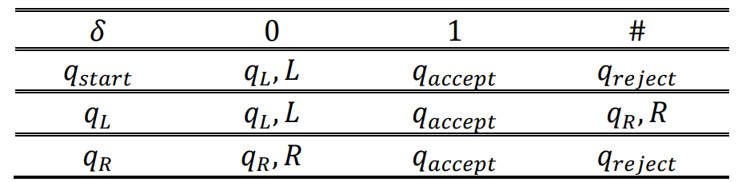
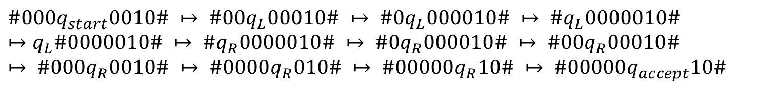


2.1.1. Deterministic
Deterministic Turing machine $M=\{Q,Σ,q_{start},q_{reject},q_{accept},δ\}$
L
#
0
0
0
0
0
1
0
#
$$Q=\{States\}$$
$$Σ=\left\{Alphabelt\right\}=\{0,1,\#\}$$
$$δ=Q × Σ→Q × Σ × \{L, R\}$$
$$\#000q_{start}0010\# ↦ \#00q_{L}00010\# ↦ \#0q_{L}000010\# ↦ \#q_{L}0000010\# ↦q_{L}\#0000010\# ↦ \#q_{R}0000010\# ↦ \#0q_{R}000010\# ↦ \#00q_{R}00010\# ↦ \#000q_{R}0010\# ↦ \#0000q_{R}010\# ↦ \#00000q_{R}10\# ↦ \#00000q_{accept}10\#$$
R
Notes:
Q x xichma x {L, R} is a function

Slide 25
2.1.2. Nondeterministic
Nondeterministic Turing machine $M=\{Q,Σ,q_{start},q_{reject},q_{accept},δ\}$
$$δ=Q × Σ→f(Q × Σ × \left\{L, R\right\})$$

Slide 26





Deterministic
Nondeterministic
$$f(n)$$
$$q_{reject}$$
$$q_{accept}$$
…
…
$$q_{accept}/q_{reject}$$
$$q_{accept}$$

Slide 27
Polynomial number of SPACE
PSPACE
Nonderterministic Turing machine in Polynomial number of step
NP
coNP
complement of NP
P = coP
Polynomial number of step
Notes:
Q x xichma x {L, R} is a function

Slide 28
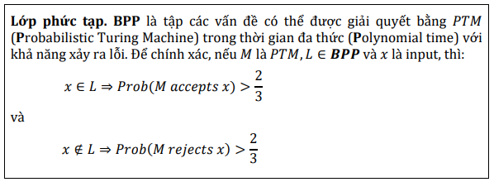
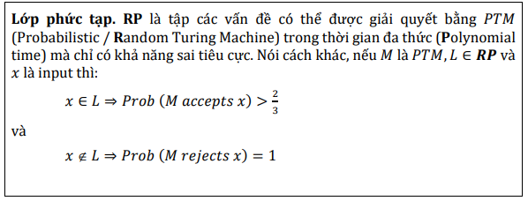









2.1.3. Probability
$$0.14$$
$$(q_{9},σ_{2},L)$$
$$0.23$$
$$(q_{17},σ_{18},R)$$
$$(q_{6},σ_{16})$$
$$(q_{17},σ_{18},R)$$
$$0.08$$
$$(q_{21},σ_{23},L)$$
$$0.55$$

Slide 29

2.1.3. Probability
Probabilistic Turing Machine in Polynomial time với khả năng xảy ra lỗi
BPP
Probabilistic / Random Turing Machine in Polynomial time with false negative only
Probabilistic / Random Turing Machine in Polynomial time with false positive only
RP
coRP
ZPP = RP $∩$ coRP
Probabilistic / Random Turing Machine in Polynomial time with Zero error

Slide 30
PSPACE
NP
BPP
coNP
RP
coRP
ZPP
P

Slide 31
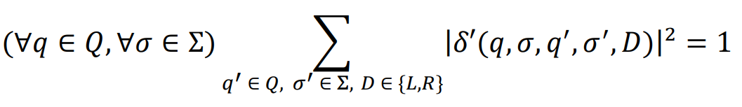
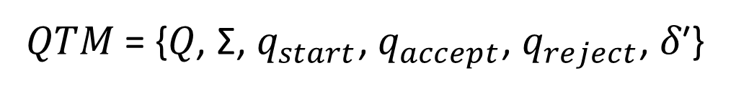

2.1.3. Quantum
Quantum Turing machine $M=\{Q,Σ,q_{start},q_{reject},q_{accept},δ\}$
𝑄𝑇𝑀 = {𝑄, Σ, $q_{start}$, $q_{accept}$, $q_{reject}$, 𝛿′}
𝛿′: 𝑄 × 𝛴 × 𝑄 × 𝛴 × {𝐿, 𝑅} → ℂ

Slide 32








$$c_{0}$$
$$\text{(}Trạng thái_{9}\text{)}$$
$$c_{1}$$
$$\text{(}Trạng thái_{16}\text{)}$$
($Trạng thái_{6}$)
$$…$$
$$c_{n−1}$$
$$\text{(}Trạng thái_{7}\text{)}$$

Slide 33
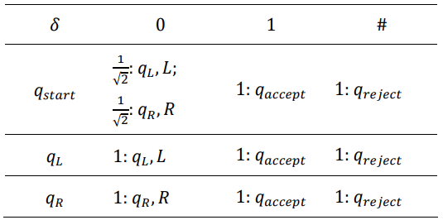
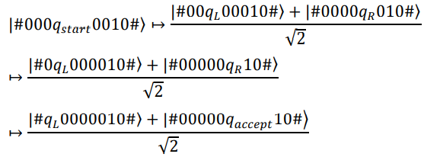
2.1.3. Quantum

Slide 34
2.1.3. Quantum
PSPACE
BQP
NP
coNP
Quantum Turing Machine in Polynomial time with Bounded error
BPP
ZQP
Quantum Turing Machine in Polynomial time with Zero error
EQP
RP
coRP
Quantum Turing Machine in Polynomial Exactly time with no error
ZPP
P

Slide 35
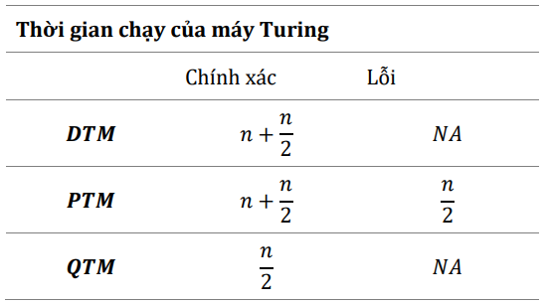
2.1.4. Summary

Slide 36
2.2. Chapter 6: Algothritm
Deutsch
Deutsch – Jozsa
Grover
Simon
Shor
Notes:
Q x xichma x {L, R} is a function

Slide 37
3. CE perspective
Điều khiển các toán tử
Máy tính cổ điển
(Master)
Vi xử lý lượng tử (Slave)
Trả về kết quả thực thi

Slide 38
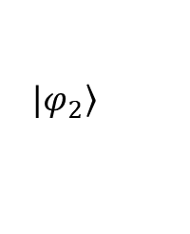
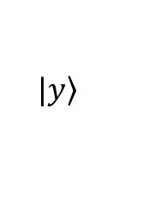
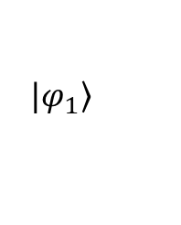

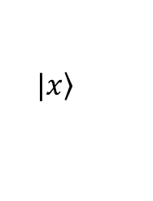
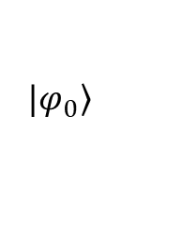



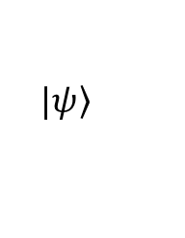

3.1. Architecture
Qubit
Quantum Gate: X, Y, Z, CNOT,
$$\left.|x\right\rangle$$
$$\left.|ψ\right\rangle$$
H
$$\left.|y\right\rangle$$
$$A$$
H
$$B$$
$$⇑$$
$$⇑$$
$$⇑$$
$$\left.|φ_{0}\right\rangle$$
$$\left.|φ_{1}\right\rangle$$
$$\left.|φ_{2}\right\rangle$$

Slide 39
4. SE perspective

Slide 40




4. Quantum Programming
Quantum Programming mindset
Quantum assembly languages: QASM, Blackbird
Quantum programming languages: QCL - quantum compution language, Q# (imperative) and QML, Quipper, QFC and QPL (like Haskell, functional)
Notes:
Blackbird^{[8][9]} is a quantum instruction set and intermediate representation used by Xanadu and Strawberry Fields. It is designed to represent continuous-variable quantum programs that can run on photonic quantum hardware.
cQASM,^{[2]} also known as common QASM, is a hardware-agnostic QASM which guarantees the interoperability between all the quantum compilation and simulation tools. It was introduced by the QCA Lab at TUDelft.
Quantum Computation Language (QCL) is one of the first implemented quantum programming languages.^{[1]} The most important feature of QCL is the support for user-defined operators and functions. Its syntax resembles the syntax of the C programming language and its classical data types are similar to primitive data types in C. One can combine classical code and quantum code in the same program.
A language developed by Microsoft to be used with the Quantum Development Kit.^{[25]}
QML is a Haskell-like quantum programming language by Altenkirch and Grattage.^{[41][36]} Unlike Selinger's QPL, this language takes duplication, rather than discarding, of quantum information as a primitive operation. Duplication in this context is understood to be the operation that maps {\displaystyle |\phi \rangle } to {\displaystyle |\phi \rangle \otimes |\phi \rangle }, and is not to be confused with the impossible operation of cloning; the authors claim it is akin to how sharing is modeled in classical languages. QML also introduces both classical and quantum control operators, whereas most other languages rely on classical control.
An operational semantics for QML is given in terms of quantum circuits, while a denotational semantics is presented in terms of superoperators, and these are shown to agree. Both the operational and denotational semantics have been implemented (classically) in Haskell.^{[42]}
Quipper was published in 2013.^{[50][51]} It is implemented as an embedded language, using Haskell as the host language.^{[52]} For this reason, quantum programs written in Quipper are written in Haskell using provided libraries. For example, the following code implements preparation of a superposition
QFC and QPL are two closely related quantum programming languages defined by Peter Selinger. They differ only in their syntax: QFC uses a flow chart syntax, whereas QPL uses a textual syntax. These languages have classical control flow but can operate on quantum or classical data. Selinger gives a denotational semantics for these languages in a category of superoperators.

Slide 41
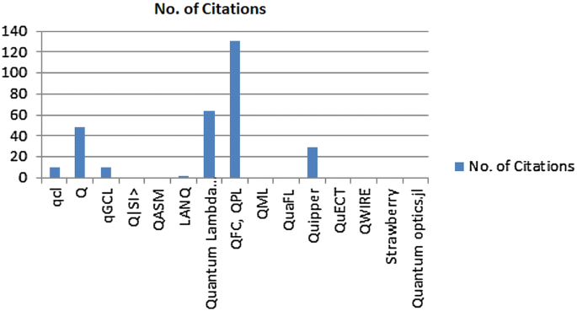
4. Quantum Programming
Notes:
Blackbird^{[8][9]} is a quantum instruction set and intermediate representation used by Xanadu and Strawberry Fields. It is designed to represent continuous-variable quantum programs that can run on photonic quantum hardware.
cQASM,^{[2]} also known as common QASM, is a hardware-agnostic QASM which guarantees the interoperability between all the quantum compilation and simulation tools. It was introduced by the QCA Lab at TUDelft.
Quantum Computation Language (QCL) is one of the first implemented quantum programming languages.^{[1]} The most important feature of QCL is the support for user-defined operators and functions. Its syntax resembles the syntax of the C programming language and its classical data types are similar to primitive data types in C. One can combine classical code and quantum code in the same program.
A language developed by Microsoft to be used with the Quantum Development Kit.^{[25]}

Slide 42
Why should we learn Haskell?
void swap(int &a, int &b) {
int t = a;
a = b;
b = t;
}
int partition (int arr[], int low, int high) {
int pivot = arr[high];
int left = low;
int right = high - 1;
while(true) {
while(left <= right && arr[left] < pivot) left++;
while(right >= left && arr[right] > pivot) right--;
if (left >= right) break;
swap(arr[left], arr[right]);
left++;
right--;
}
swap(arr[left], arr[high]);
return left;
}
void quickSort(int arr[], int low, int high) {
if (low < high) {
int pi = partition(arr, low, high);
quickSort(arr, low, pi - 1);
quickSort(arr, pi + 1, high);
}
}
quicksort :: (Ord a) => [a] -> [a]
quicksort [] = []
quicksort (x:xs) =
let smallerSorted = quicksort [a | a <- xs, a <= x]
biggerSorted = quicksort [a | a <- xs, a > x]
in smallerSorted ++ [x] ++ biggerSorted
Haskell
C++

Slide 43
4.1. Mindset
Dữ liệu cổ điển
Lượng tử hóa
Thực thi
Đo
Có thể lặp
Dữ liệu cổ điển

Slide 44
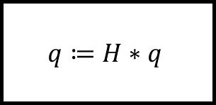
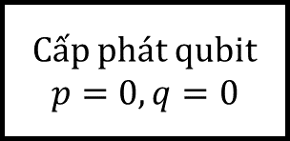
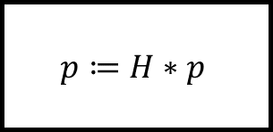
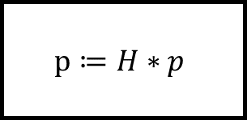
4.2. Imperative prgramming
Cấp phát qubit $p=0,q=0$
$$q≔H∗q$$
Đo q
$$p≔H∗p$$
$$p≔H∗p$$

Slide 45
5. NC perspective
Kênh công khai
Alice
Eve
Bob
Kênh lượng tử

Slide 46
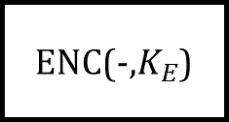


5.1. Crytography
Symmetry
T
ENC
E
DEC
T
Alice
Bob
Asymmetry
T
ENC(-,$K_{E}$)
E
DEC(-,$K_{D}$)
T
Alice
Bob
$K_{E}$ công khai

Slide 47


5.1. Quantum crytography
x
$$\left.|0\right\rangle ,\left.|1\right\rangle$$
Alice
Bob
Eve
$$\left.|+\right\rangle ,\left.|−\right\rangle$$

Slide 48







5.2. Quantum teleportion
$$\left.|ψ\right\rangle$$
Bước 4
Tái tạo $\left.|ψ\right\rangle$
Bước 3
đo đạc
$$B$$
Bước 2
$A,\left.|ψ\right\rangle$ tương tác
$$A$$
Bước 1
$$\left.|ψ\right\rangle$$
$A,B$ vướng víu
Alice
Bob
Không -Thời gian

Slide 49


5.3. Quantum compress data & error – code correction
Chuỗi $2^{12}$
Chuỗi tượng trưng $2^{12∗0.8}\sim 2^{10}$
100001111111
000000001111
111111111000

Slide 50











Ảo
$$θ$$
Thực
$$c_{1}$$
$$c_{2}$$
$$V$$
$$V′$$
$${c_{1}+c}_{2}$$
$$V+V′$$
$$c_{1}$$
$$V$$
$$c_{2}$$
$$V′$$

Slide 51



Ảo
$$c$$
$$θ$$
Thực
$$c×i$$

Slide 52




Ảo
$$c^{2}$$
$$c$$
$$θ$$
Thực
$$c^{3}$$

Slide 53







$$ω^{2}$$
$$ω^{1}$$
$$ω^{3}$$
$$ω^{0}$$
$$ω^{4}$$
$$ω^{6}$$
$$ω^{4}$$

Slide 54







$$z$$
$$y$$
$$x$$
$$V$$
r$V$
$$−V$$
$$V$$

Slide 55
Hadamard
Chuyển cơ sở
Tính toán
Quay về cơ sở ban đầu

Slide 56










$$V$$
$$V$$
$$V′$$
$$V′$$
$$\sqrt{2}$$
$$1$$
$$\sqrt{2}$$
$$1$$
$$1$$
$$\sqrt{2}$$
(i) Không trực giao
(ii) Trực giao nhưng không chuẩn tắc
(ii) Chuẩn tắc

Slide 57






$$∗$$
$$∗$$
$$∗$$
$$∗$$
$$∗$$
$$V_{0} V_{1}V_{2}…V_{n}…\overline{V}$$

Slide 58

6
2
1
0
1
2
5
3
5
10
3
4

Slide 59
5
5
0
0
1
2
2
0
5
15
3
4

Slide 60



0
1
j
$$⋮$$
i
$$n−1$$

Slide 61







$$\frac{1}{3}$$
$$\frac{1}{2}$$
0
1
$$\frac{1}{6}$$
$$\frac{1}{6}$$
$$\frac{2}{3}$$
$$\frac{5}{6}$$
$$\frac{1}{3}$$
2

Slide 62



$$\frac{1}{6}$$
$$\frac{1}{2}$$
0
1
$$\frac{1}{3}$$
$$\frac{1}{3}$$
$$\frac{5}{6}$$
$$\frac{2}{3}$$
$$\frac{1}{6}$$
2

Slide 63









0
$$M\left[0,j\right]$$
$$M\left[i,0\right]$$
1
j
$$M\left[1,j\right]$$
$$⋮$$
$$M\left[i,1\right]$$
i
$$M\left[n−1,j\right]$$
$$n−1$$
$$M\left[i,n−1\right]$$

Slide 64




1
$$\frac{1}{2}$$
$$\frac{1}{2}$$
$$\frac{1}{2}$$
$$\frac{1}{2}$$
0
3
$$\frac{1}{2}$$
$$\frac{1}{2}$$
$$\frac{1}{2}$$
$$\frac{1}{2}$$
2

Slide 65






$$1$$
3
$$\frac{1}{3}$$
$$1$$
$$\frac{1}{2}$$
1
4
$$\frac{1}{3}$$
$$\frac{1}{3}$$
$$1$$
0
5
$$\frac{1}{3}$$
$$\frac{1}{3}$$
$$1$$
$$\frac{1}{2}$$
2
6
$$\frac{1}{3}$$
$$1$$
7

Slide 66






$$\frac{1}{\sqrt{2}}$$
$$\frac{−i}{\sqrt{2}}$$
$$\frac{1}{2}$$
0
1
$$\frac{i}{2}$$
$$1$$
$$1$$
$$−i$$
2
0
1
$$1$$
2

Slide 67











1
$$\frac{1}{\sqrt{2}}$$
$$\frac{1}{\sqrt{2}}$$
$$−$$
$$\frac{1}{\sqrt{2}}$$
$$\frac{1}{\sqrt{2}}$$
$$−$$
0
3
$$\frac{1}{\sqrt{2}}$$
$$\frac{1}{\sqrt{2}}$$
$$\frac{1}{\sqrt{2}}$$
$$\frac{1}{\sqrt{2}}$$
2

Slide 68









$$1$$
3
$$\frac{−1+I}{\sqrt{6}}$$
$$1$$
$$\frac{1}{\sqrt{2}}$$
1
4
$$\frac{−1−I}{\sqrt{6}}$$
$$\frac{1−I}{\sqrt{6}}$$
$$1$$
0
5
$$\frac{−1+I}{\sqrt{6}}$$
$$\frac{−1−I}{\sqrt{6}}$$
$$1$$
$$\frac{1}{\sqrt{2}}$$
2
6
$$\frac{1−I}{\sqrt{6}}$$
$$1$$
7

Slide 69










$$\frac{1}{3}$$
$$\frac{1}{2}$$
0
1
$$\frac{1}{6}$$
$$\frac{1}{6}$$
$$\frac{2}{3}$$
$$G_{M}=$$
$$\frac{5}{6}$$
$$\frac{1}{3}$$
2
$$\frac{1}{3}$$
$$\frac{1}{3}$$
$$\frac{2}{3}$$
$$G_{N}=$$
a
b
$$\frac{2}{3}$$

Slide 70







$$\frac{2}{18}$$
0b
0a
$$\frac{1}{18}$$
$$\frac{1}{6}$$
$$\frac{2}{6}$$
1a
1b
$$\frac{1}{9}$$
$$\frac{2}{9}$$
2a
2b

Slide 71


Slide 72


Slide 73
)
)
)
)
)
)
)
)
)

Slide 74








Slide 75


Slide 76


Slide 77


Slide 79


Slide 80


Slide 81
Điều khiển
Điều khiển
Đầu vào
Qubit trợ giúp
Đầu ra
Mục tiêu
Mục tiêu

Slide 82


$$\left.|\right\rangle$$
$$\left.|x_{i}\right\rangle$$

Slide 83






$$f\left(0\right)=0$$
$$f\left(0\right)=1$$
$$f\left(0\right)=0$$
$$f\left(1\right)=0$$
Hằng
$$f\left(0\right)=0$$
$$f\left(1\right)=1$$
Cân bằng
$$f\left(0\right)=1$$
$$f\left(1\right)=0$$
Cân bằng
$$f\left(0\right)=1$$
$$f\left(1\right)=1$$
Hằng

